Slide 1
Database Normalization
Exclusive Content
(GATE/NET Short Tips & Tricks)

Slide 2
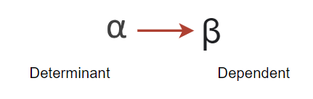
Functional Dependency
If we know the value of α, we can get the value of β from the relation.
α | β
a | 1
b | 2
c | 3
d | 4
For each value of α we should have same value of β.
α | β
a | 1
a | 2
C | 3
d | 4
Here in this case, on same value of α we have different value of β.
t1 ->
t2 ->
If t1[α] = t2[α]
then
t1[β] = t2[β]
should be equal
tn ->

Slide 3
Practice Q/A
A | B | C | D | E
a | 2 | 3 | 4 | 5
2 | a | 3 | 4 | 5
a | 2 | 3 | 6 | 5
a | 2 | 3 | 6 | 6
Which of the following functional dependency holds true as per the rule and why?
A-> BC
DE -> C
C -> DE
BC -> A

Slide 4
Closure of Functional Dependencies
Closure method helps in finding all the CANDIDATE KEYS in a relation.
While dealing with the normalization concept and functional dependencies, this is the most important and crucial concept.
With the help of candidate keys, we can identify PRIME and NON PRIME attributes which further helps in dealing with the normal forms.
E.g. R(A, B, C, D) F.D. Set – { A->B, B->C, C->D }
A+ = ABCD
B+ = BCD
C+ = CD
D+ = D
A can determine each attribute of relation R, Hence it is a candidate key.
B can not determine each attribute of relation R, Hence it is not candidate key.
C can not determine each attribute of relation R, Hence it is not candidate key.
D can not determine each attribute of relation R, Hence it is not candidate key.

Slide 5
Also have to check the combination, with ‘A’
(AB)+ = ABCD Hence, it is also a candidate key
But according to rule, candidate key is minimal in nature. So we cannot take AB as candidate key.
Hence , only ‘A’ will be the only candidate key.
PRIME ATTRIBUTE – {A}
NON-PRIME ATTRIBUTE – {B,C,D}
Tips and Tricks (Finding Candidate Key in Seconds)
Check the attribute which is not on the RHS, that attribute will sure be the part of candidate key.

Slide 6
Problem Statements
1. Consider a relation R having attributes as R(ABCD), functional dependencies are given below:
AB->C, C->D, D->A
Identify the set of candidate keys possible in relation R. List all the set of prime and non prime attributes.
3. Consider a relation R having attributes as R(ABCDE), functional dependencies are given below:
B->A, A->C, BC->D, AC->BE
Identify the set of candidate keys possible in relation R. List all the set of prime and non prime attributes.
4. Consider a relation R having attributes as R(ABCDEF), functional dependencies are given below:
A->BCD, BC->DE, B->D, D->A
Identify the set of candidate keys possible in relation R. List all the set of prime and non prime attributes.
2. Relation R(ABCDE) having functional dependencies as :
A->D, B->A, BC->D, AC->BE
Identify the set of candidate keys possible in relation R. List all the set of prime and non prime attributes.

Slide 7
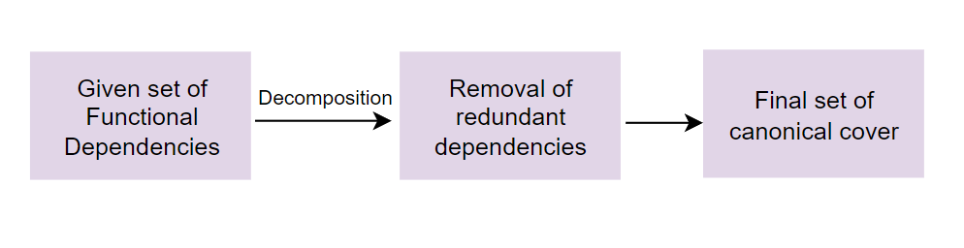
Canonical Cover
One of the most important topic on functional dependency – Finding the canonical cover.
Canonical cover is the minimized set from given functional dependencies, after removing the redundant set of FDs.

Slide 8
Problem Statement
Designing a student database involves certain dependencies which are listed below:
X ->Y
WZ ->X
WZ ->Y
Y ->W
Y ->X
Y ->Z
The task here is to remove all the redundant FDs for efficient working of the student database management system.

Slide 9
Problem Statement
Debix Pvt Ltd needs to maintain database having dependent attributes ABCDEF. These attributes are functionally dependent on each other for which functionally dependency set F given as:
{A -> BC, D -> E, BC -> D, A -> D} Consider a universal relation R1(A, B, C, D, E, F) with functional dependency set F, also all attributes are simple and take atomic values only. Then the minimal cover F’ of functional dependency set F is?

Slide 10
Normalization
When we define a large database as a single relation, there are chances of data redundancy and inconsistency.
This leads to various problems such as maintaining the huge amount of data, improper utilization of disk space and resources and many more.
In-order to handle these issues, NORMALIZATION comes into the picture.
Normalization helps us to reduce the redundancy from relations, divides the larger table into smaller tables and helps in dealing with insertion, deletion and updatation anomalies.

Slide 11

Data Anomalies

Slide 12
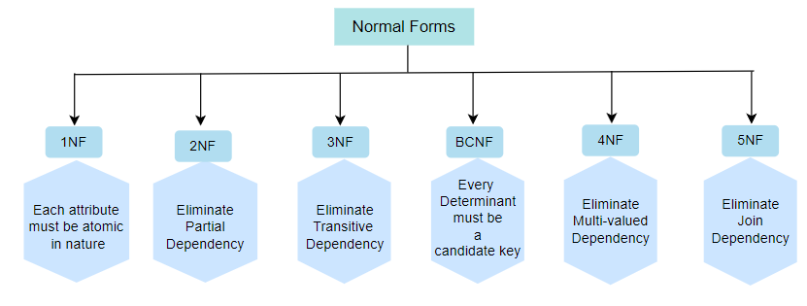
Normalization

Slide 13
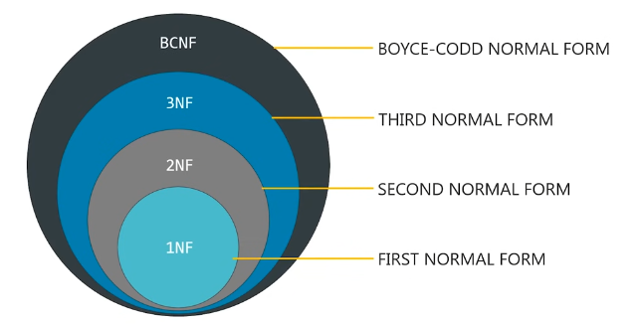

Slide 14
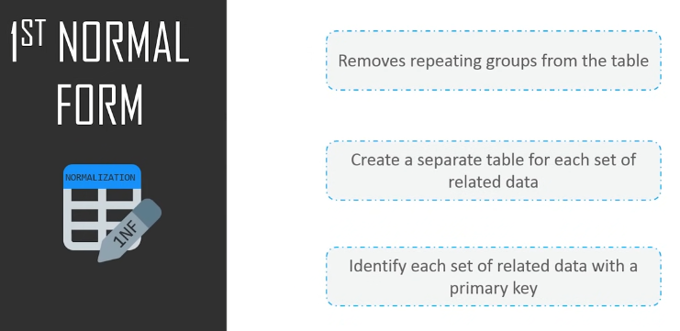

Slide 15
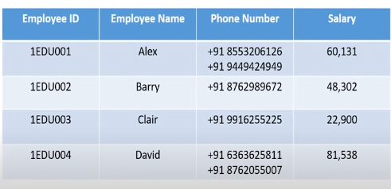
1NF

Slide 16
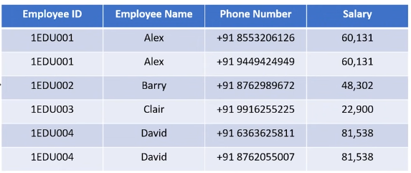
1NF - Decomposition

Slide 17
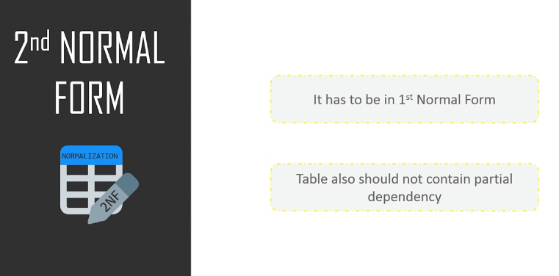

Slide 18
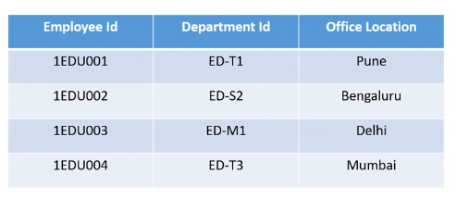
2-NF
Employee ID and Department ID forms the P.K in this case.
Department ID determines Office Location – Clear cut case of Partial Dependency

Slide 19
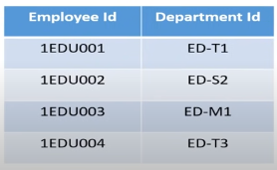
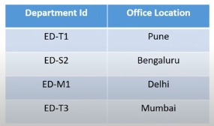
2-NF - Decomposition

Slide 20
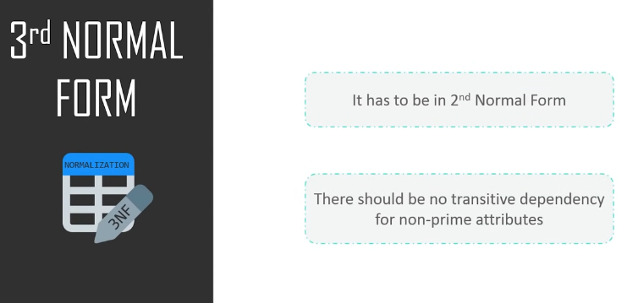
Transitivity?

Slide 21
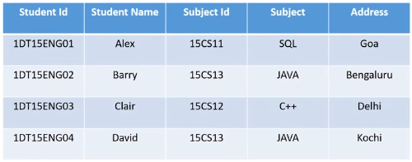
3-NF
Student ID → Subject ID → Subject --- Transitive Dependency

Slide 22
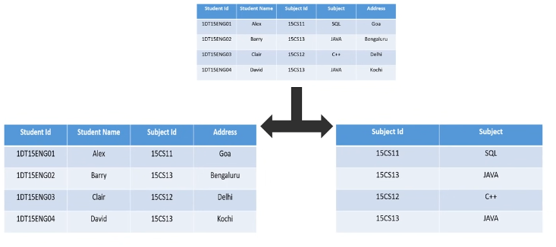
3-NF - Decomposition

Slide 23
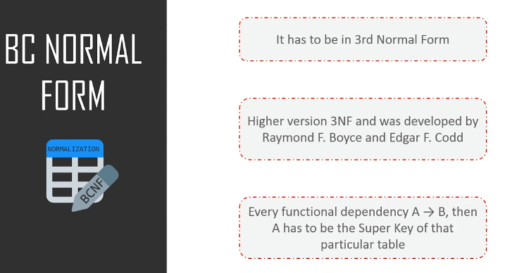

Slide 24
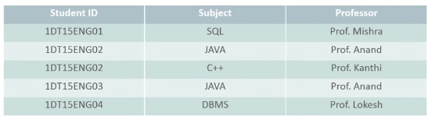
BCNF
One student can enroll for multiple subjects, there can be multiple professors teaching one subject, For each subject professor has been assigned to the student.
Student ID and Subject are the PA here and Professor is NPA.
Professor → Subject – Clear cut case for BCNF

Slide 25
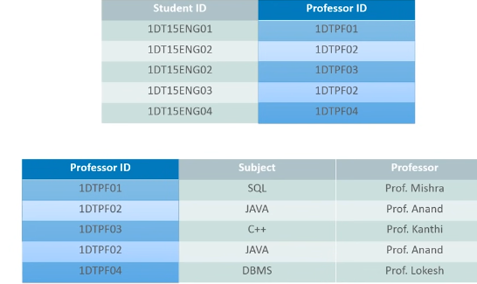
BCNF - Decomposition
Why we added new column as Professor ID?
By doing this we are removing the NPA → PA dependency.
Professor ID will be the primary key or super key for the second table for identifying the records uniquely.

Slide 26
Normalization
Tips and Tricks: How to identify quickly that relation is in which form.
2NF (when is it not): if there is dependency from X -> Y
(X is a subset of candidate key AND Y is non-prime attribute) – then R is not in 2NF
3NF (when is it): if there is a dependency from X -> Y
(X is a super key or candidate key OR Y is a prime attribute)
(If all attributes comes out to be prime – R is in 3NF)
BCNF (when is it): if there is a dependency from X -> Y
(X is super key or candidate key)

Slide 27
Practice Set
Relation R(ABCDE) having dependencies as:
CE -> D
D ->B
C -> A
Highest normal form? C.K set?
3. Relation R(ABCDEFGHI) having dependencies as:
AB -> C
BD -> EF
AD -> GH
A -> I
Highest normal form? C.K set?
5. Relation R(ABCDE) having dependencies as:
BC -> ADE
D -> B
Highest normal form? C.K set?
2. Relation R(ABCDEF) having dependencies as:
AB -> C
DC -> AE
E -> F
Highest normal form? C.K set?
4. Relation R(ABCDE) having dependencies as:
AB -> CD
D -> A
BC -> DE
Highest normal form? C.K set?
6. Relation R(ABC) having dependencies as:
A -> B
B -> C
C -> A
Highest normal form? C.K set?

Slide 28
Problem Statement
1. The task is to design Student Performance Analysis System for a university, focusing on analyzing and evaluating student grades across courses. The system will track student names, course numbers, registration numbers, and grades. Functional dependencies include student name and course number determining grade, as well as registration number and course number determining grade. Additionally, student name determines registration number, and registration number determines student name. Identify the highest normal form for minimal redundancy by listing all the prime and non-prime attributes.

Slide 29
Problem Statement
2. Consider a relation P having fields as F1, F2, F3, F4, F5 with the functional dependencies as follows:
F1 -> F3
F2 -> F4
(F1,F2) -> F5
In terms of normalization, this table is in which normal form. Describe the prime and non-prime attributes for the relation P.

Slide 30
Problem Statement
3. DBA of a university information management system wants to remove redundancy by considering the following dependencies and relation R(R_N, Name, Dob, Age) for the system. For better optimization of database, he needs to normalize the database by identifying the relevant CK keys and normal form.
Dob ->Age
Name ->Rno
Age -> Eligibility
Rno -> Name
C_N -> Cname
C_N -> Instructor
(R_N, C_N) -> Grade

Slide 31
Decomposition of Tables
A | B
a | 1
b | 2
a | 3
c | 3
d | 3
e | 3
R(ABC) having FD as B -> C
Identify the normal form and candidate key for the same?
Apply decomposition.
A | B | C
a | 1 | x
b | 2 | y
a | 3 | z
c | 3 | z
d | 3 | z
e | 3 | z
B | C
1 | x
2 | y
3 | z

Slide 32
Practice Set
Consider a relation R(ABCDEFGHI) having FDs as:
AB -> C
AD -> GH
BD -> EF
A -> I
H -> J
Identify that relation is in which normal form and the candidate key by determining the prime and non prime attributes.
Apply the decomposition if needed to remove the redundancy.
Identify how many new tables will be formed after the decomposition.
2. Relation R having attributes as (A, B, C, D, E) having the functional dependencies as follows:
A -> B
B -> E
C -> D
Identify that relation is in which normal form and the candidate key by determining the prime and non prime attributes.
Apply the decomposition if needed to remove the redundancy.
Identify how many new tables will be formed after the decomposition.

Slide 33
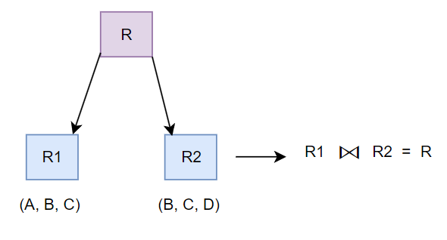
Loss-less Join Decomposition
Loss-Less Properties
Attributes(R1) U Attributes(R2) = Attributes(R)
Attributes(R1) ∩ Attributes(R2) ≠ Φ
R1 ∩ R2 = CK of R1 or CK of R2
If any of the condition fails, then it will be considered as Lossy decomposition.
Loss-less always doesn’t mean that some tuple or information will be lost.
In some cases when we combine the decomposed tables, then some extra tuples or information are also added.
This extra tuple that adds up in the resultant relation is known as SPURIOUS TUPLE.

Slide 34
Problem Statement
1. Raj faces a problem in resolving the decomposition issue with the relation R having attributes as (A,B,C,D,E,F,G,H,I,J) having functional dependencies set as:
AB -> C
B -> F
F -> GH
D -> IJ
A -> DE
The task here is to determine the highest normal form of relation R by determining the prime and non-prime fields.
Check if relation is in 3NF or not. If not then, remove the redundancy and decompose the relation. Also, identify the possible number of relations after the decomposition and check if the decomposition is lossy or loss-less.

